Slide 1



CoVid-19
LESSON 1: Stopping the Spread
Find Press it to turn red when you aren’t talking.
Have a paper and pencil ready to use
HEALTH LITERACY WORK GROUP

Slide 2
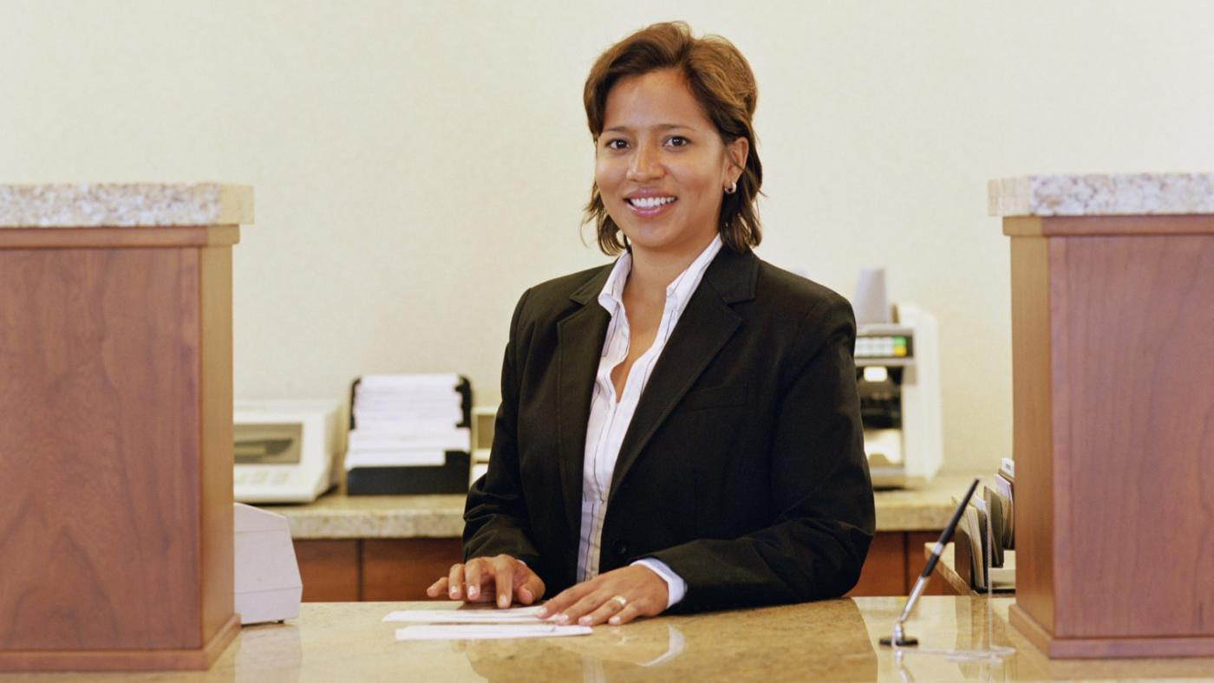
Stopping the Spread: What to Do? Juanita’s Dilemma
Juanita works in a bank. She lives with her husband, Frank; her 65-year old mother, Teresa; and her 10-year old daughter, Mary. She is scared of the coronavirus. The bank has put up two posters. The news says to “social distance.” The governor says to “Shelter in Place.” Mary’s school has been closed. Juanita wants to know what to do to keep herself and her family safe. It is a question most of us have.
Let’s look at one of the posters the bank put up. First, just look at the pictures.
Write down what you think the pictures mean?
https://www.cdc.gov/coronavirus/2019-ncov/downloads/stop-the-spread-of-germs.pdf

Slide 3
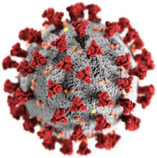

Now let’s Look at the Words Used in the Poster
(let’s read them together)
Coronavirus: A sickness you can catch like a cold.
The very little germs look like this:
Image from: wikipedia
CoVid-19: A brand new or “novel” coronavirus that is easy to catch. When a sickness is new we have to learn how to test for, watch for it. and treat it.
Spread: A sickness is “spread” when it goes from one person to many people.
Prevent: To stop something from happening. Preventing an illness is not letting it go from person to person.

Slide 4


Draw a Line to the Matching Word
A.
When a sickness goes from one person to many people
A sickness, like a cold, that you can catch from other people
Stopping a sickness from going from one person to another
A new kind of coronavirus
Prevent
Spread
Coronavirus
CoVid-19
B.
C.
D.

Slide 5

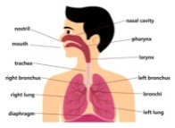
More Words
Germs: Very small living things that cause people to get sick.
Respiratory Disease: A sickness that hurts the parts of your body that help you to breathe.
Symptoms: What happens to your body when you are sick: like a fever, cough, and not being able to breathe well.
Mild Symptoms: Changes in a person’s sick body that aren’t very bad. They can rest at home to get better.
Severe Symptoms: Changes in a person’s sick body that are so bad they have to be in the hospital.

Slide 6
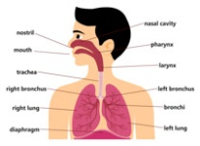
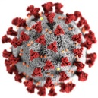
Draw a Line to the Matching Word
A sickness that hurts the parts of your body that help you to breathe.
Changes in a person’s sick body that aren’t very bad. They can rest at home to get better.
Very small living things that cause people to get sick.
Changes in a person’s sick body that are so bad they have to be in the hospital.
A.
Mild Symptoms
Respiratory Disease
Severe Symptoms
Germs
B.
C.
D.

Slide 7

More Words
Avoid: Try very hard not to do something.
Close Contact: Less than six feet from another person.
6 feet
Social Distancing: At least six feet away from others.
Shelter in Place: Staying at home away from others except when essential (like buying groceries and getting medicine).
Essential: something that has to happen to support life

Slide 8
More Matching
Trying very hard not to do something.
Less than six feet from another person.
At least six feet away from others.
Staying at home except when necessary.
Shelter in Place
Close Contact
Avoid
Social Distancing
A.
B.
C.
D.

Slide 9
More Words
Disinfect: Cleaning something and killing germs.
Frequently: Something that happens very often.
Surfaces: Things you can touch, like tables, doorknobs, and phone screens.

Slide 10
More Matching
Frequently
Surfaces
Disinfect
A.
Clean something to kill germs.
Something that happens very often.
The outside of things like tables, doorknobs, and phone screens.
B.
C.

Slide 11


Disease Fighters
Centers for Disease Control (CDC): The United States government organization that fights diseases around the U.S.
https://www.cdc.gov/coronavirus/2019-nCoV/index.html
World Health Organization (WHO): A worldwide organization that fights diseases around the globe. https://www.who.int/emergencies/diseases/novel-coronavirus-2019

Slide 12
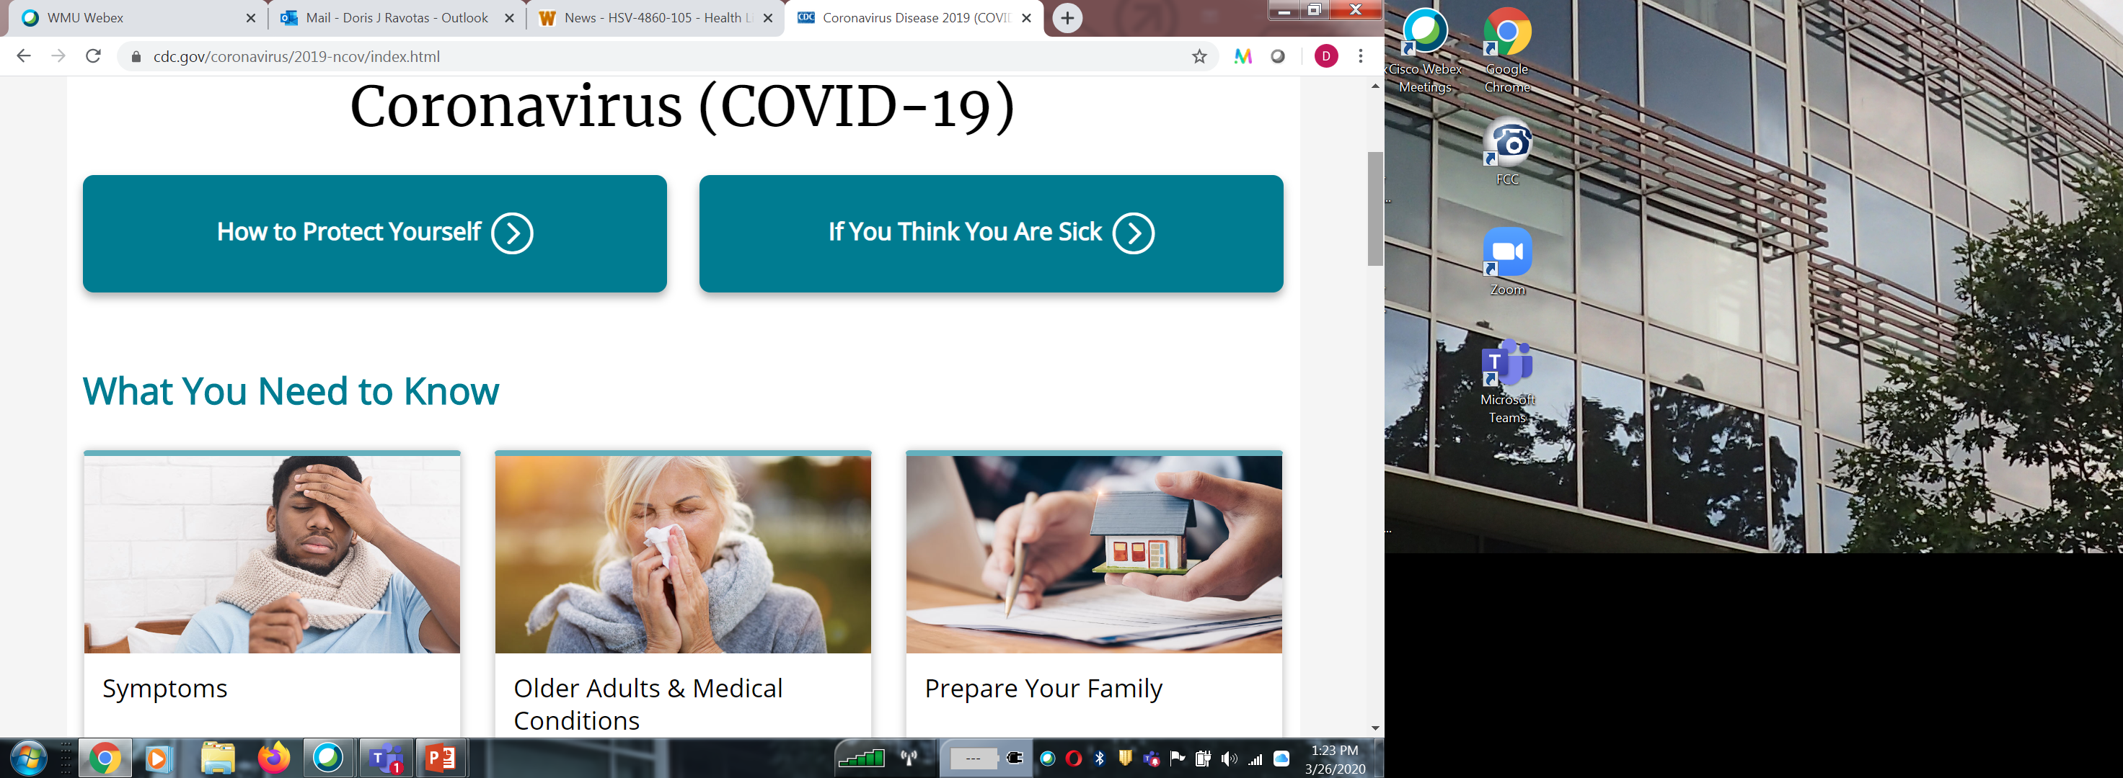
The COVID-19 CDC Website

Slide 13
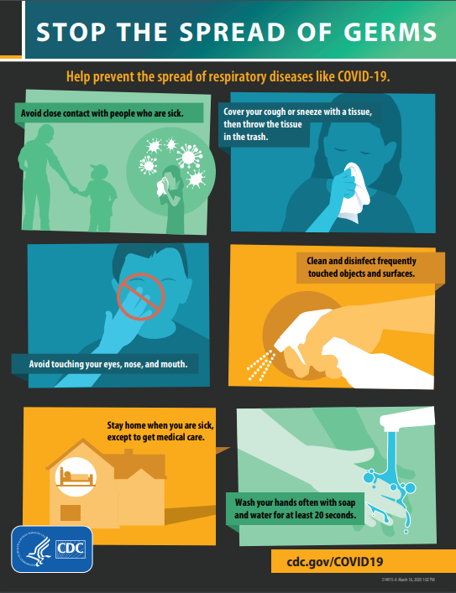
Let’s Go Back and Read the Poster
https://www.cdc.gov/coronavirus/2019-ncov/downloads/stop-the-spread-of-germs.pdf
What questions do you have about stopping the spread of CoVid-19?

Slide 14
When Juanita Read the Poster
She Had These Questions:
1.
How can I catch the CoVid-19 virus?
2.
How sick do people get?
3.
Do I really have to stay home? How can I say “hi” to someone I know?
4.
What if I am going to cough and I don’t have a tissue?
5.
What and how should I disinfect?
6.
How do I know how long 20 seconds is when I wash my hands?

Slide 15
Juanita Wants to Know: How Could We Get CoVid-19?
The germs come from people who have CoVid-19 when they sneeze or cough. The germs are in little droplets that come out of people’s mouths. Some people don’t know they have it or think it is just a cold.
You can get it if:
You stand too close and the germs land in your mouth, eyes, or nose.
You stand too close and the germs land on your hands or arms and then you touch your face.
You walk into germs that are in the air (can live in air for up to three hours).
You touch surfaces that have germs on them and then touch your face (can live on surfaces for a few hours up to a few days).

Slide 16
How Could We Catch CoVid-19? (Fill in the right word)
a. surfaces b. face c. germs d. CoVid-19 e. cough f. air g. mouth
The ________are in little droplets that come from people who have ______ when they sneeze or ______. They may not look sick. You can get it if:
The germs land in your ______ or eyes.
The germs land on your hands or arms and then you touch your _______.
You walk into germs that are in the ____ and they get into your eyes or mouth.
You touch ________ that have germs on them and then touch your face.

Slide 17
Juanita wants to know:
How sick will people get?
Most people will have mild symptoms. They will feel like they have a bad cold or like they are not sick.
Some people will have severe symptoms and have to go to the hospital. The elderly and people with other medical problems often have severe symptoms.

Slide 18
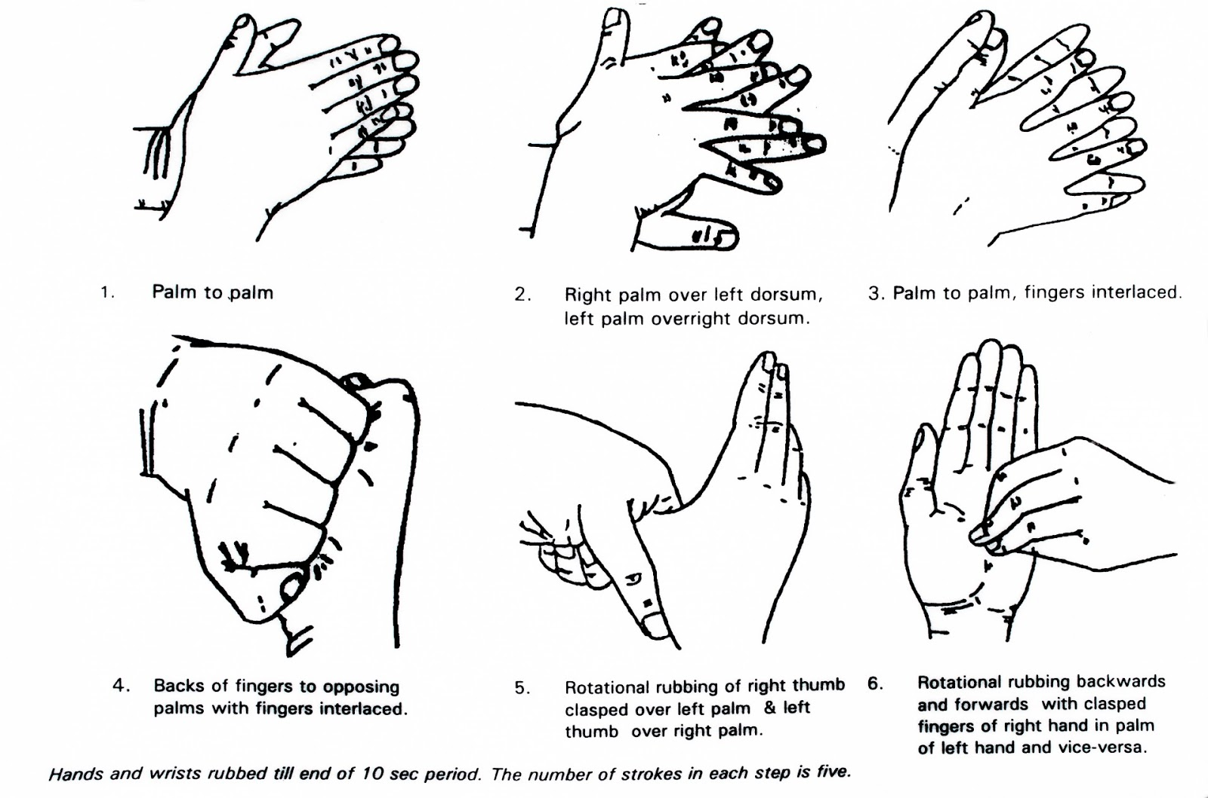
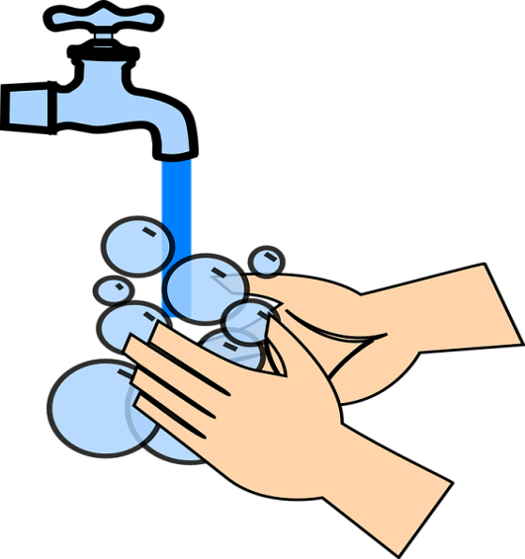

Juanita’s school sent out rules to keep safe. One of those rules helped her know how to wash her hands better. She can see how to wash every part of her hands.
Wash your hands with soap for 20 seconds
Sing the “ABC song” or “Happy Birthday” twice.

Slide 19

Juanita also found this video:

Slide 20

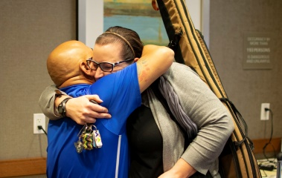

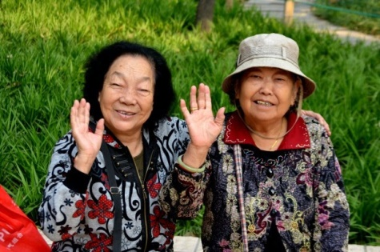
Juanita’s school rules also helped her understand social distancing at six feet:
Do NOT shake hands..
6 feet
Do NOT hug..
Say, “Namaste” or wave.

Slide 21
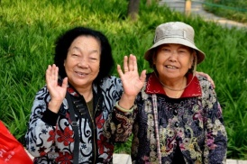



Match the Words to the Pictures
Do NOT shake hands.
Do NOT hug
Say, “Namaste”
Wave

Slide 22
Juanita wants to know what she and her family can do while “Sheltering in Place.”
She can go to work at the bank because people need to get money.
They can go out for essential things like banking, grocery shopping, getting gas, and getting medicine.
They can go out for exercise as long as they stay six feet away from people who do not live with them
Whenever they are in public they need to be six feet away from other people.

Slide 23
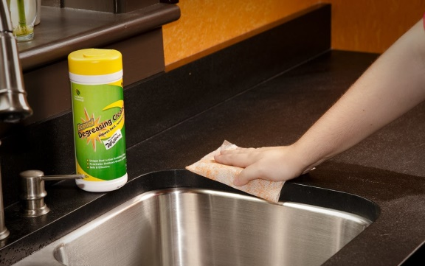



Juanita saw on the news she should clean what she touches and then disinfect with alcohol or bleach ingredients. The school rules helped her think about what she touches.
Clean with disinfectant

Slide 24
Put These Words in the Right Order
1. soap/hands/with/wash/your
2. cough/cover/your/and/sneeze
3. tissues/throw/trash/the/in
4. disinfectant/clean/with/surfaces/and/objects/and
5. distance/at/social/feet/six
6. in/means/home/shelter/stay/place

Slide 25
1. soap/hands/with/wash/your
Wash your hands with soap and water.
2. cough/cover/your/and/sneeze
Cover your cough and sneeze.
3. tissues/throw/trash/the/in
Throw the tissues in the trash.
4. disinfect/clean/with/surfaces/and/objects/and
Clean and disinfect objects and surfaces.
5. distance/at/social/feet/six
Social distance at six feet.
6. in/means/home/shelter/stay/place
Shelter in place means stay home.

Slide 26
Juanita has made a plan based on what she has learned. How will she tell her daughter about what she planned?
Social Distancing:
Sheltering in Place:
Sneezing and coughing?
Touching her face?
Cleaning and disinfecting?
Washing her hands?

Slide 27
Some things Juanita could say or show to her daughter:
Social distancing: Don’t touch other people and stay six feet away.
Sheltering in Place: We have to stay home, but you can video chat with your friends.
Sneezing and coughing? Cover your mouth with a tissue or your elbow. Throw away a tissue.
Touching her face? Don’t touch your face so germs can’t get in.
Cleaning and disinfecting? Clean and disinfect all surfaces and things you touch (like doorknobs and the TV remote). She will need to shower and wash her clothes when she comes in from work.
Washing her hands? Use soap and wash all of your hands for 20 seconds. No soap? Use hand sanitizer on all parts of your hands.

Slide 28
Make a Plan for Your Family
Include:
Social distancing
Sheltering in Place
Sneezing and coughing
Touching your face
Cleaning and disinfecting
Washing your hands

Slide 29
What questions do you have about COVID-19?
Go to the top of your screen and open the chat . Write down one or two questions that you have. We will work to include them in our series on coronavirus.

Slide 30
Next Coronavirus Topic: What is the Risk of Getting Sick and What Would I Do?
Remember you can work with your tutor before the next time. No tutor? Call the Kalamazoo Literacy Council at (269) 382-0490 ext. 222.
Best websites for the coronavirus:
https://www.cdc.gov/coronavirus/2019-nCoV/index.html
https://www.who.int/emergencies/diseases/novel-coronavirus-2019

Slide 31

Stay Healthy!
Developed by:
Dr. Doris Ravotas
Fulbright Specialist
Master Faculty Specialist
School of Interdisciplinary Health Programs
College of Health and Human Services
KLC Fellow and Health Literacy Work Group Leader
Email: doris.ravotas@wmich.edu
HEALTH LITERACY WORK GROUP

